Slide 1
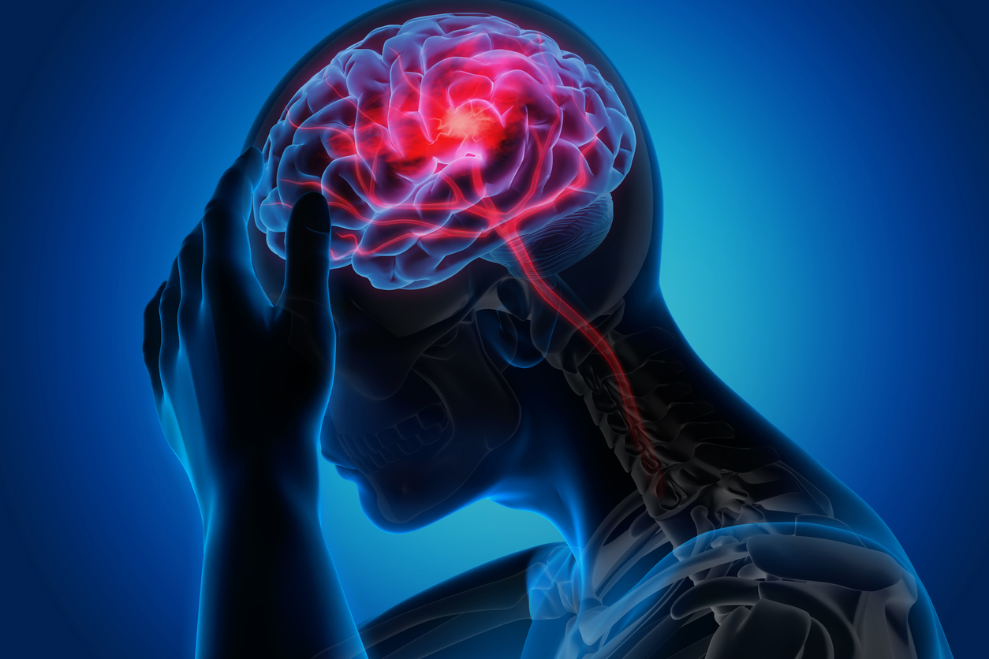

Advanced Healthcare Analytics: Predicting Stroke Risk with R
Yashwanth Reddy Kovvuri (YK291)
Department of Computer Science and Engineering
Course : Data Science – Concepts and Practice
Dr. J. Edward Swan
4th December 2023

Slide 2




Overview
Introduction
Stroke and Its predisposition
R programming in healthcare
Dataset
Data wrangling
Data visualization
Data modelling
Scope

Slide 3

Introduction
Healthcare industry is an ever growing sector with population becoming health conscious by the day. Patients want to understand how to prevent disease and disability before its onset. This creates a need for physicians to be a step ahead at each point of patient encounter.
Usage of data science and analytics can help achieve that. Prediction models, AI assisted equipment’s have been under research and are proven to be useful. Stroke prediction analysis is one such example where all risk factors contributing to the disease and the extent of their causation can be determined to formulate a trained algorithm.

Slide 4
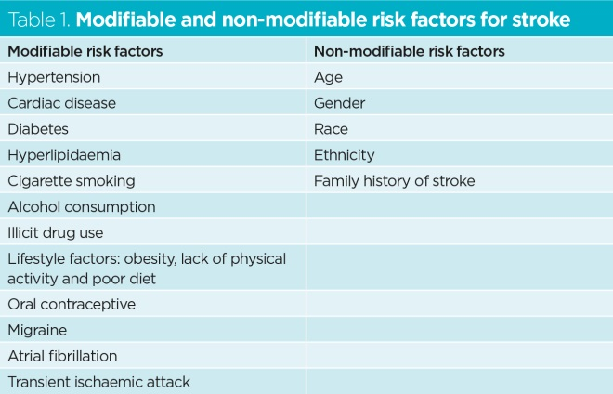

Stroke and Its predisposition
Stroke also termed as Cerebro Vascular Attack is a disruption of blood flow to the brain.
This could be due to a blocked vessel, burst or spill of the vessel or bleeding in the brain.
There are various factors which could lead to a high risk of developing stroke. These include
Modifiable factors: these can be mitigated by lifestyle changes and active life
Non-modifiable factors: these factors can’t be altered and are usually genetic or inherited broadly.

Slide 5

R programming in healthcare
Stroke ranks as the second most common cause of fatality, with an annual occurrence of 795,000 cases.
Most of these can be mitigated through screenings and changes in lifestyle habits.
Data science in healthcare has the potential to enhance outcomes for both doctors and their patients. The insights gained can then inform the assessment of different treatment approaches.
Packages used include Tidyverse, Psych, GGplot2, Dplyr, Ggally, Corrplot, Caret, RandomForest, Glmnet.
By Using R, we can get information about :
Genetics,
bioinformatics,
drug discovery,
pattern detection,
plots/graph generation,
basic stat analysis

Slide 6
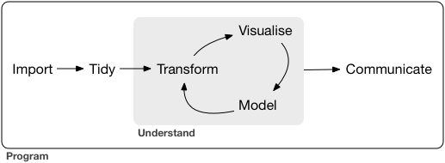
At a Glance,
Report

Slide 7
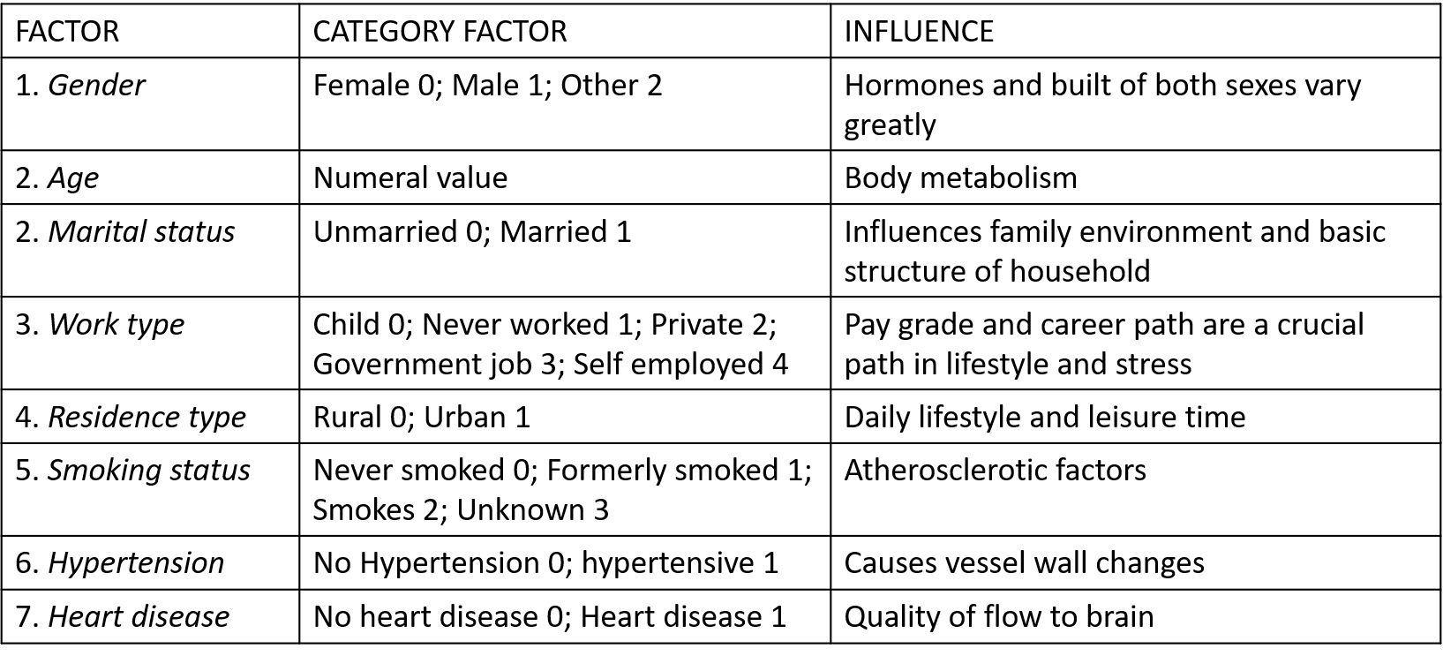

Dataset
The data set is taken from Kaggle – comprising of 5110 observations and with 12 attributes
Name is replaced by unique id . It is named as healthcare-dataset-stroke

Slide 8
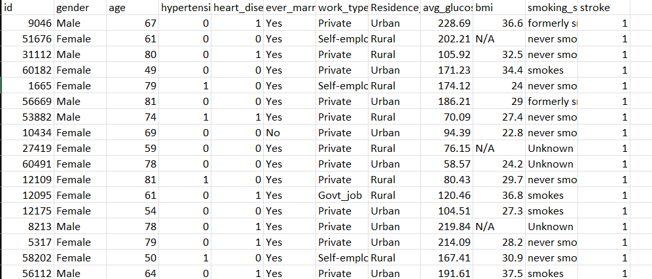

Slide 9
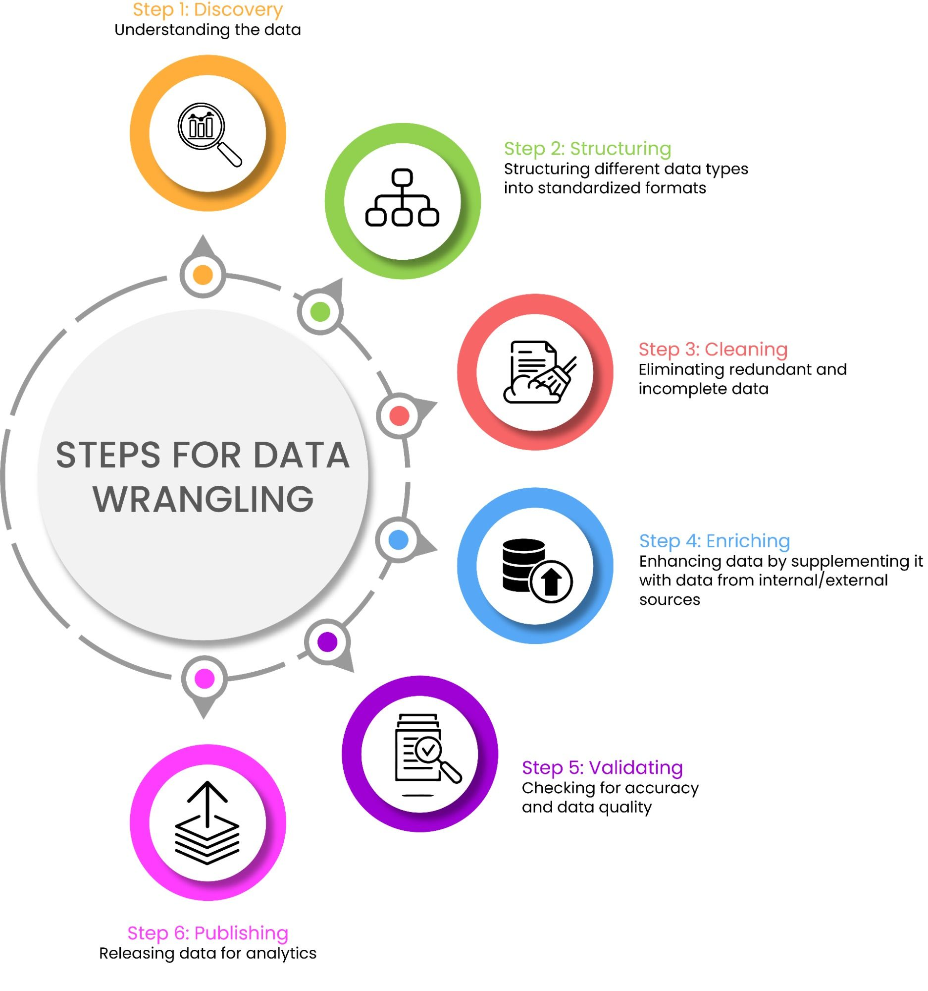
Data Wrangling
It is known as Data manipulating or data preprocessing. It includes
Data Collection - collecting raw data from Kaggle and creating file location
Data Cleaning – handling missing values, duplicate values and outliers via imputing
Data Transformation – converting data types into categorical factors
Data Aggregation – calculating summary statistics’
Data Exploration – Generating Summary Statistics, visualizing
EDA( Exploratory Data Analysis)
It is a combination of Exploration and Visualization Techniques. Useful to understand characteristics and patterns.
Can be of two types-
Principal Component Analysis
t- T-Distributed stochastic Neighbor Embedding
Removed 201 rows containing missing values

Slide 10
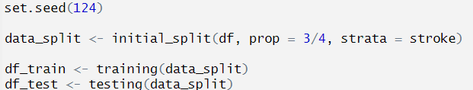

Data Preprocessing
75% of the data will be used for training, and the remaining
25% will be used for testing.
Stratified cross-validation is made easier with the help
of the R function vfold_cv, which divides a dataset
into 10 folds and then repeats the process 10 times,
making sure each fold preserves a fair representation
of the categories specified by the strata variable. For
tasks in machine learning where maintaining true
class proportions is essential, this careful distribution
is essential.

Slide 11
Data Visualization
Evaluation of the data to create an association between stroke and the given factors.
This association is depicted pictorially to understand the degree of influence of any given factor.
Interpretation- stroke is a multifactorial disease with various levels of contribution from said factors hence it is essential to monitor and create a holistic approach towards management

Slide 12
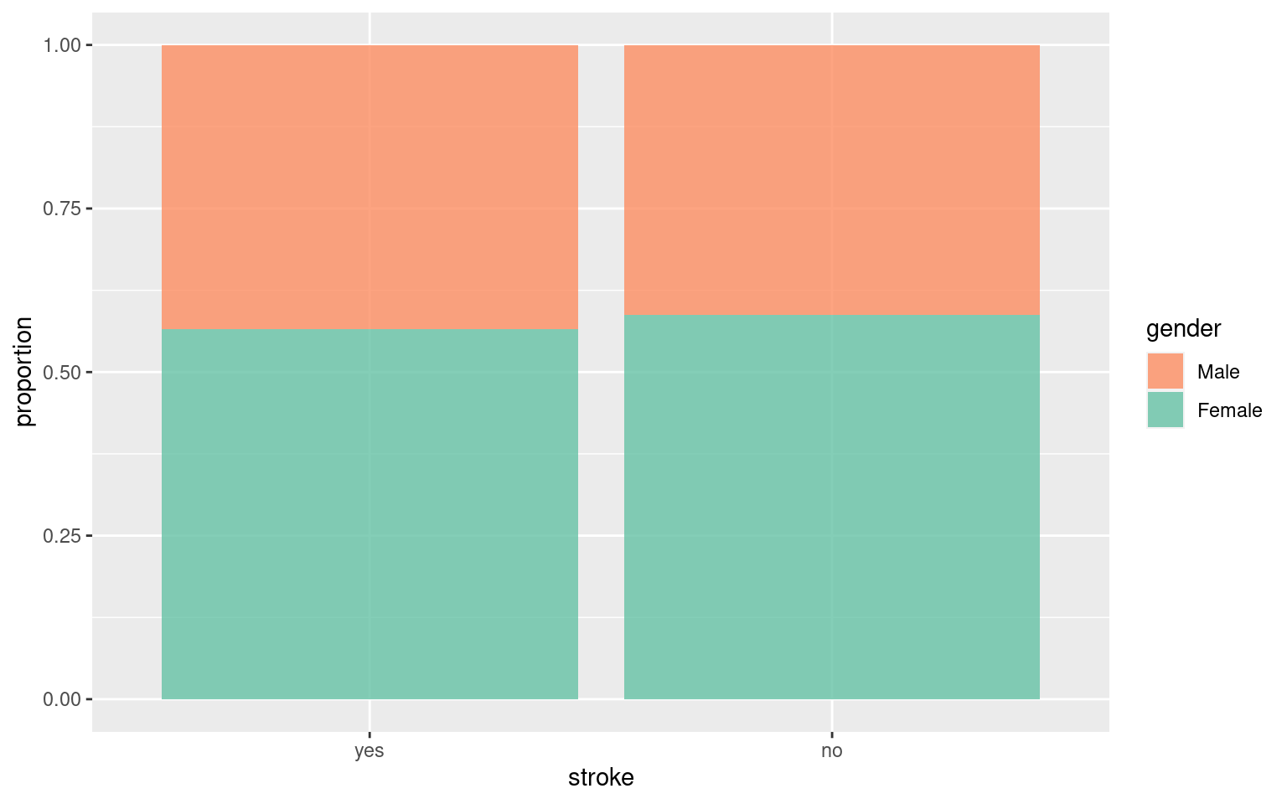
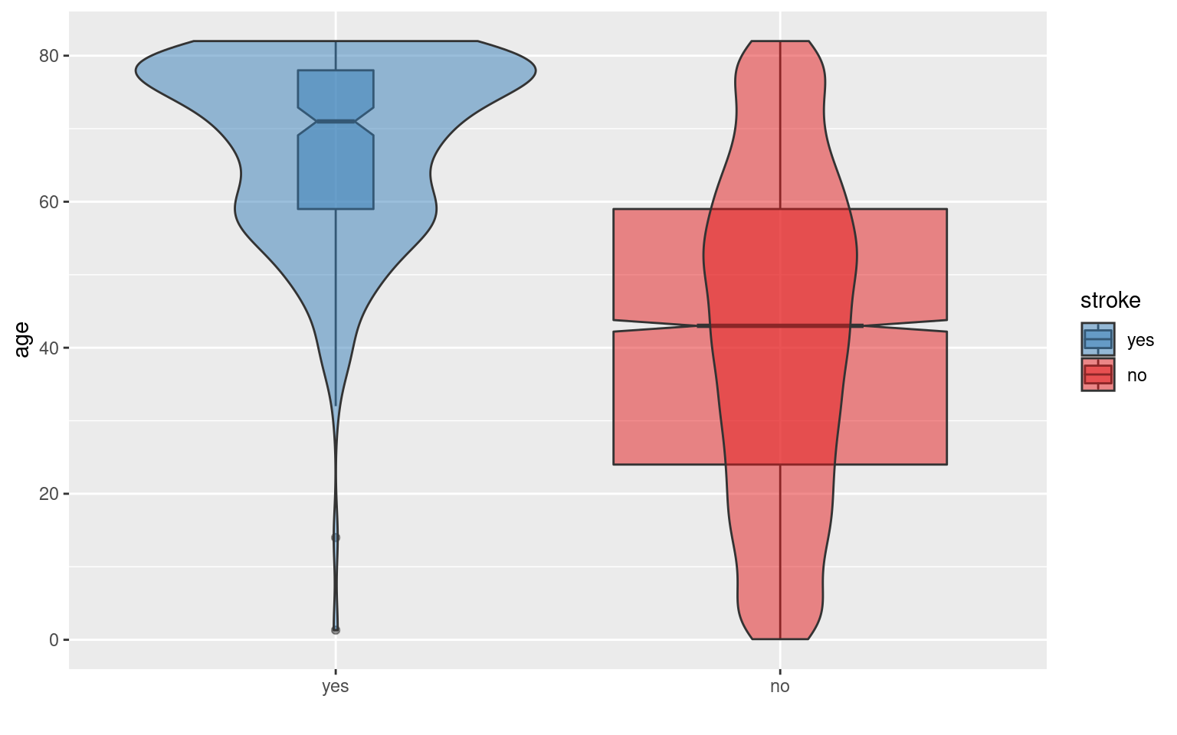
STROKE AND GENDER-
Almost identical in males and females
STROKE AND AGE- Violin curve
Higher the age, higher the risk for stroke

Slide 13
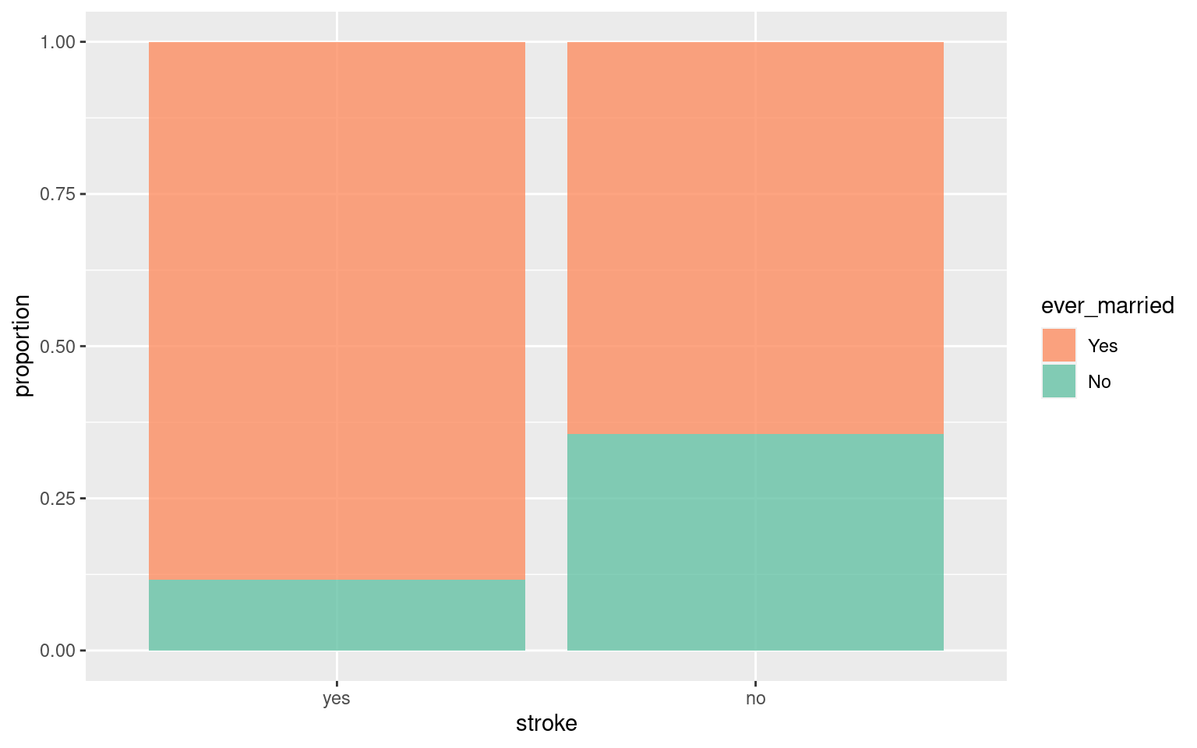
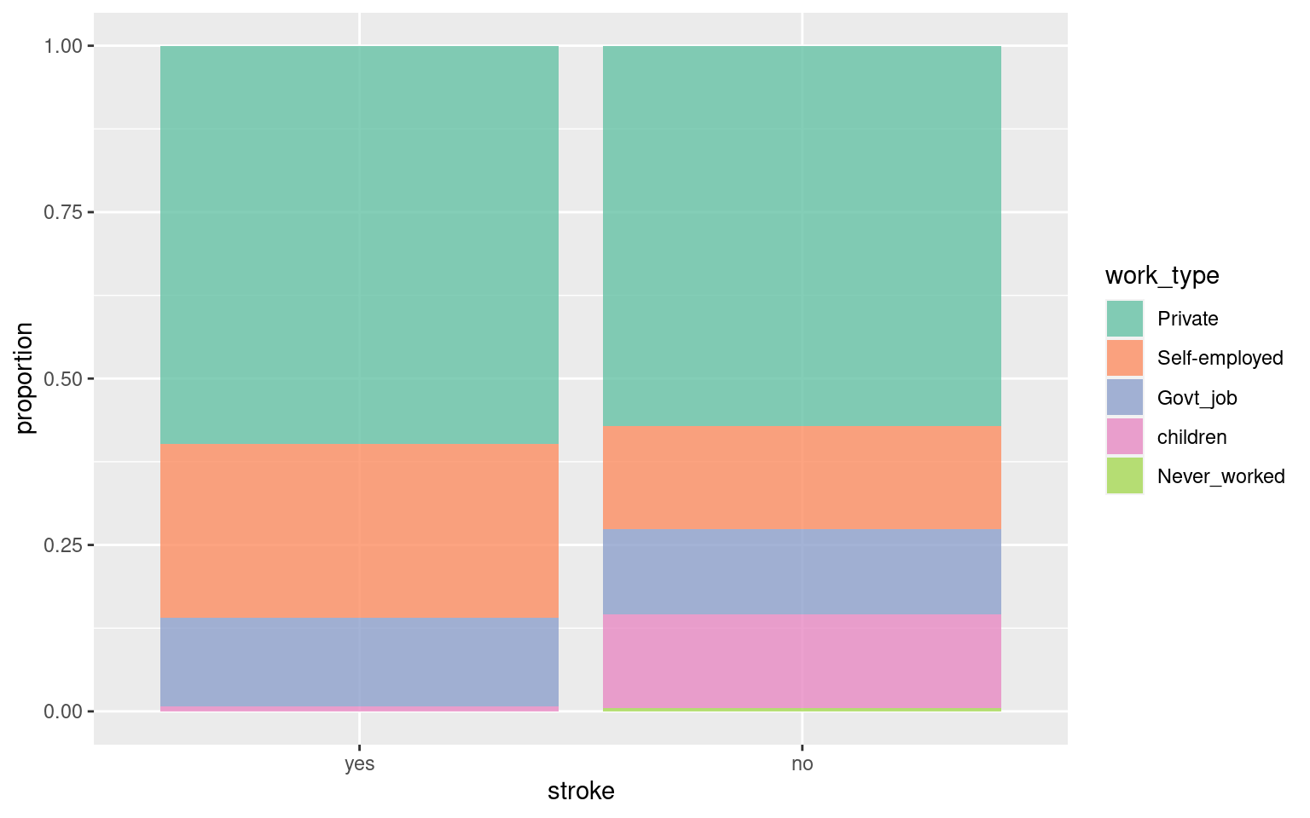
STROKE AND MARITAL STATUS
Married sector indicated higher incidence
STROKE AND WORK TYPE
Private and self employment occupations have higher risk
Children are less prone- almost negligible

Slide 14
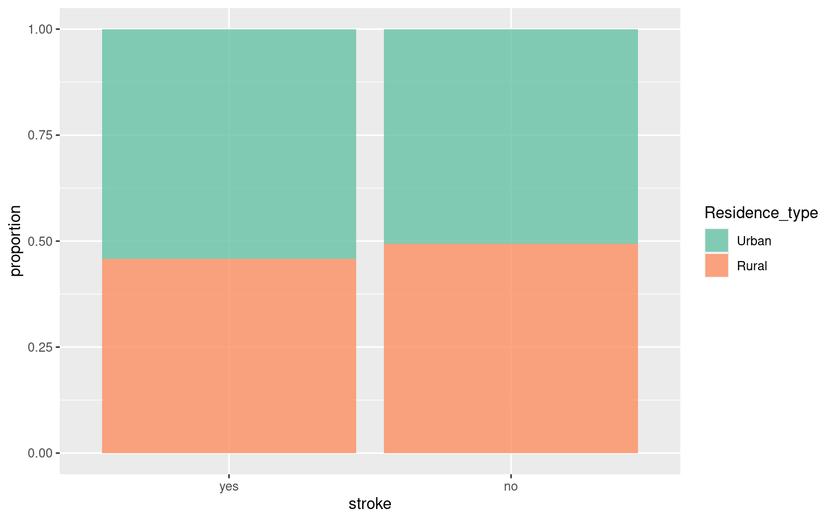
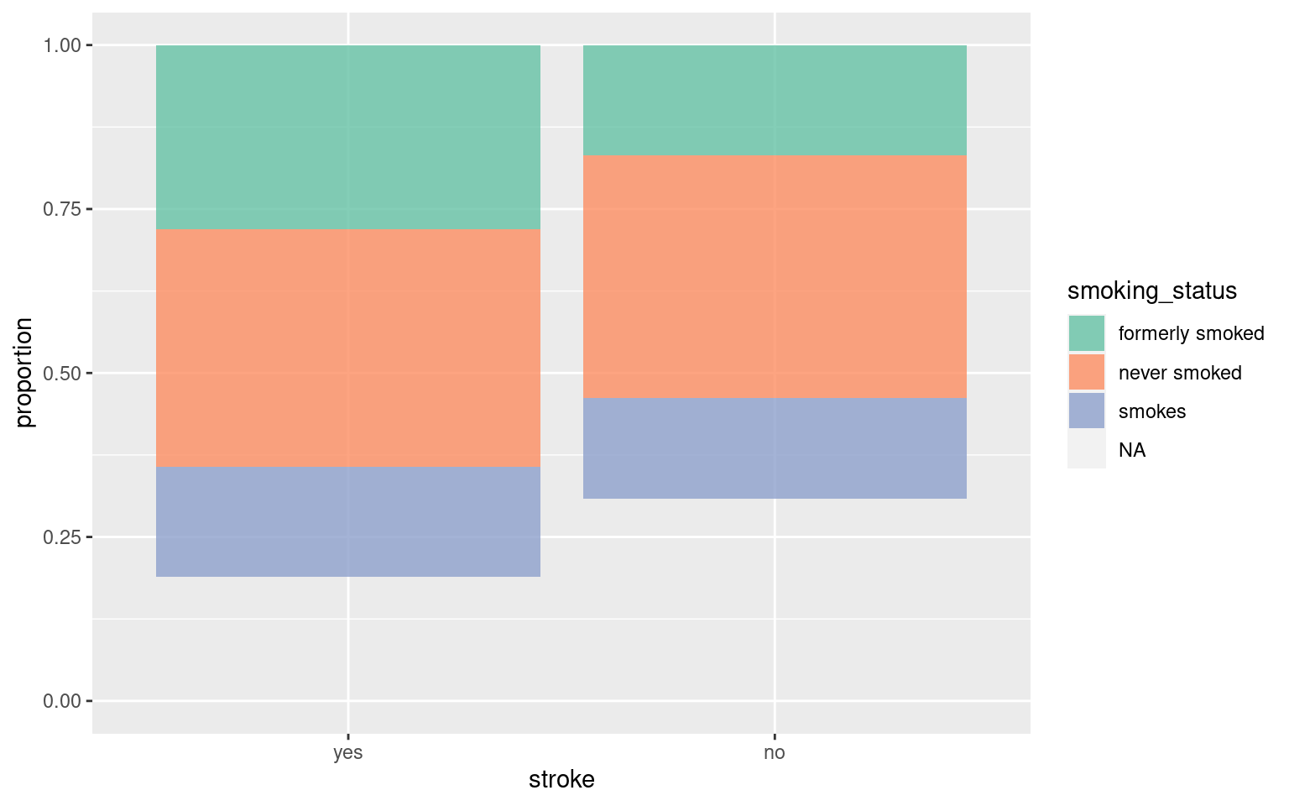
STROKE AND RESIDENCE TYPE
A little higher in urban areas
STROKE AND SMOKING STATUS
Higher incidence of stroke in all types of smokers

Slide 15
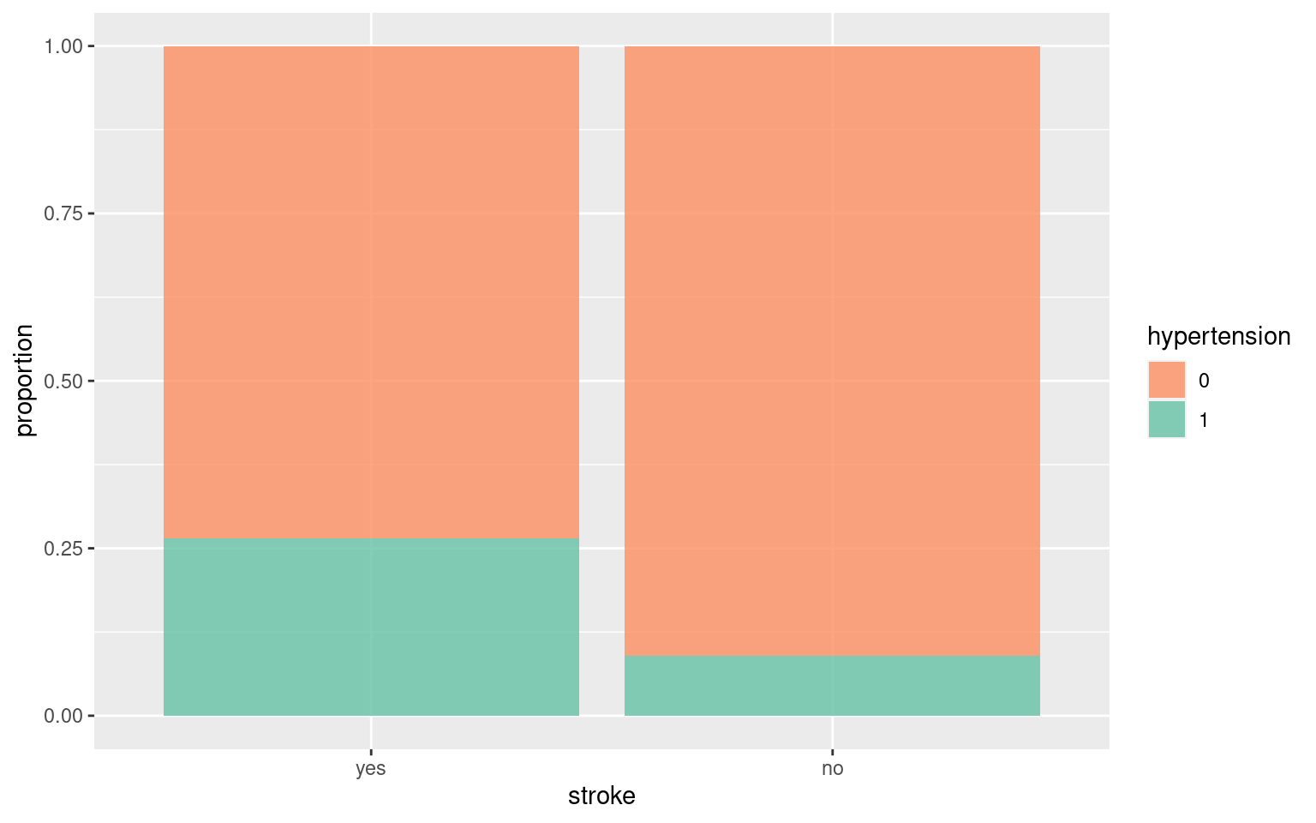
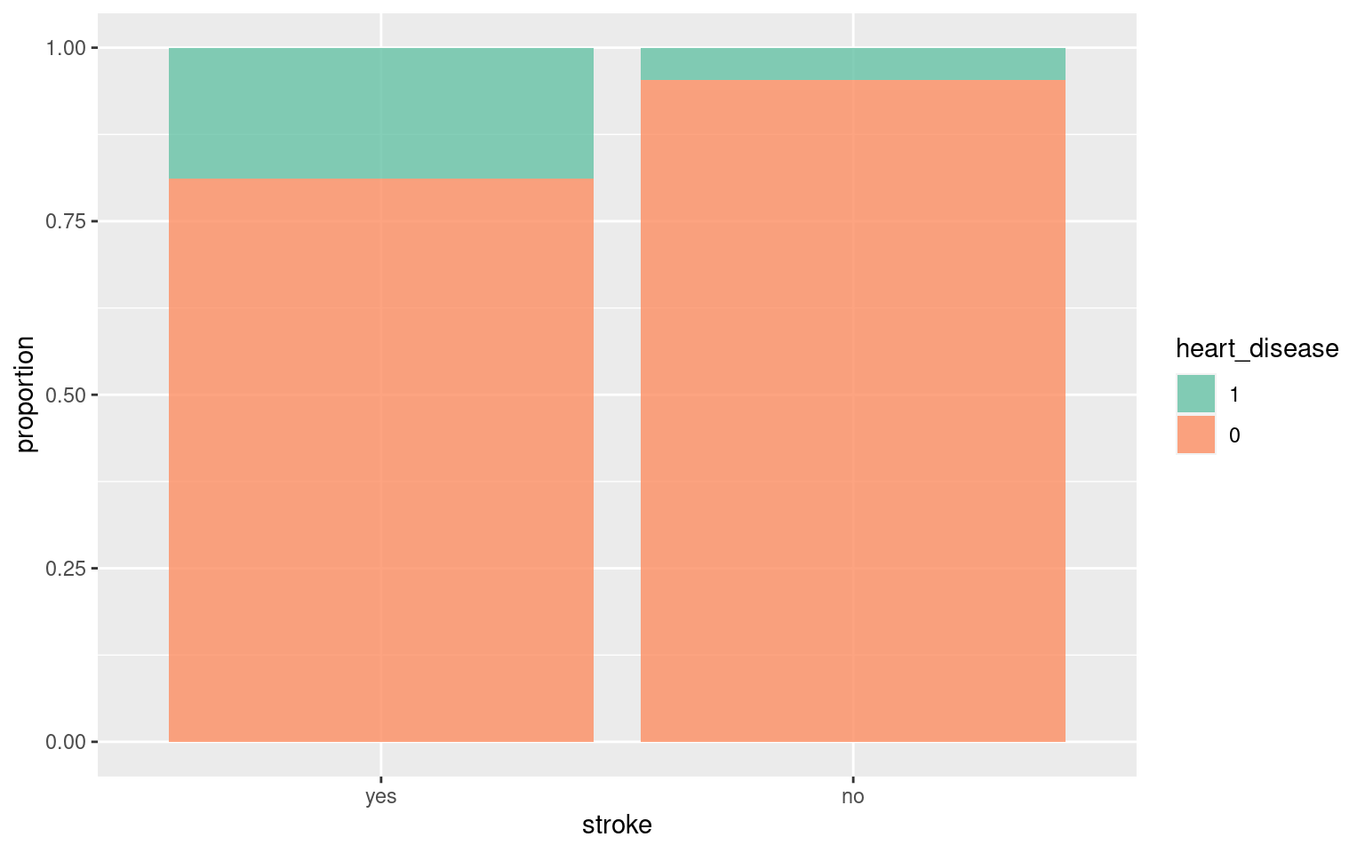
STROKE AND HYPERTENSION
Hypertension is frequent in patients with stroke
STROKE AND HEART DISEASE
Individuals with heart conditions showed higher risk for development of stroke

Slide 16
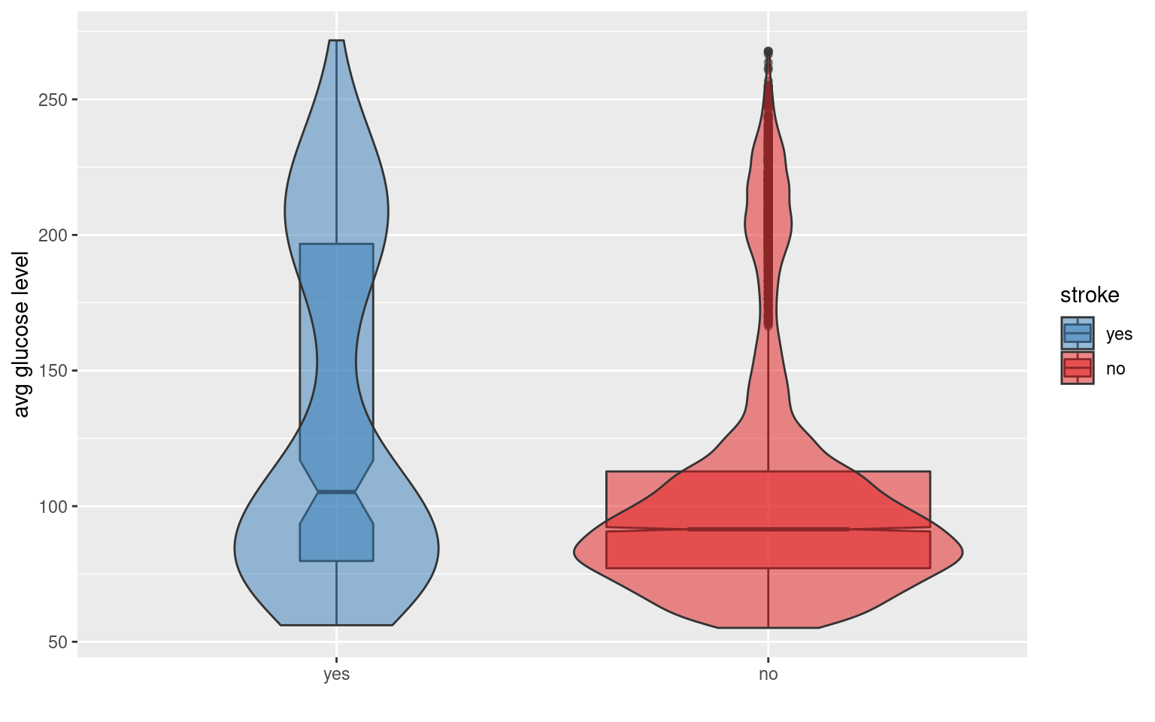
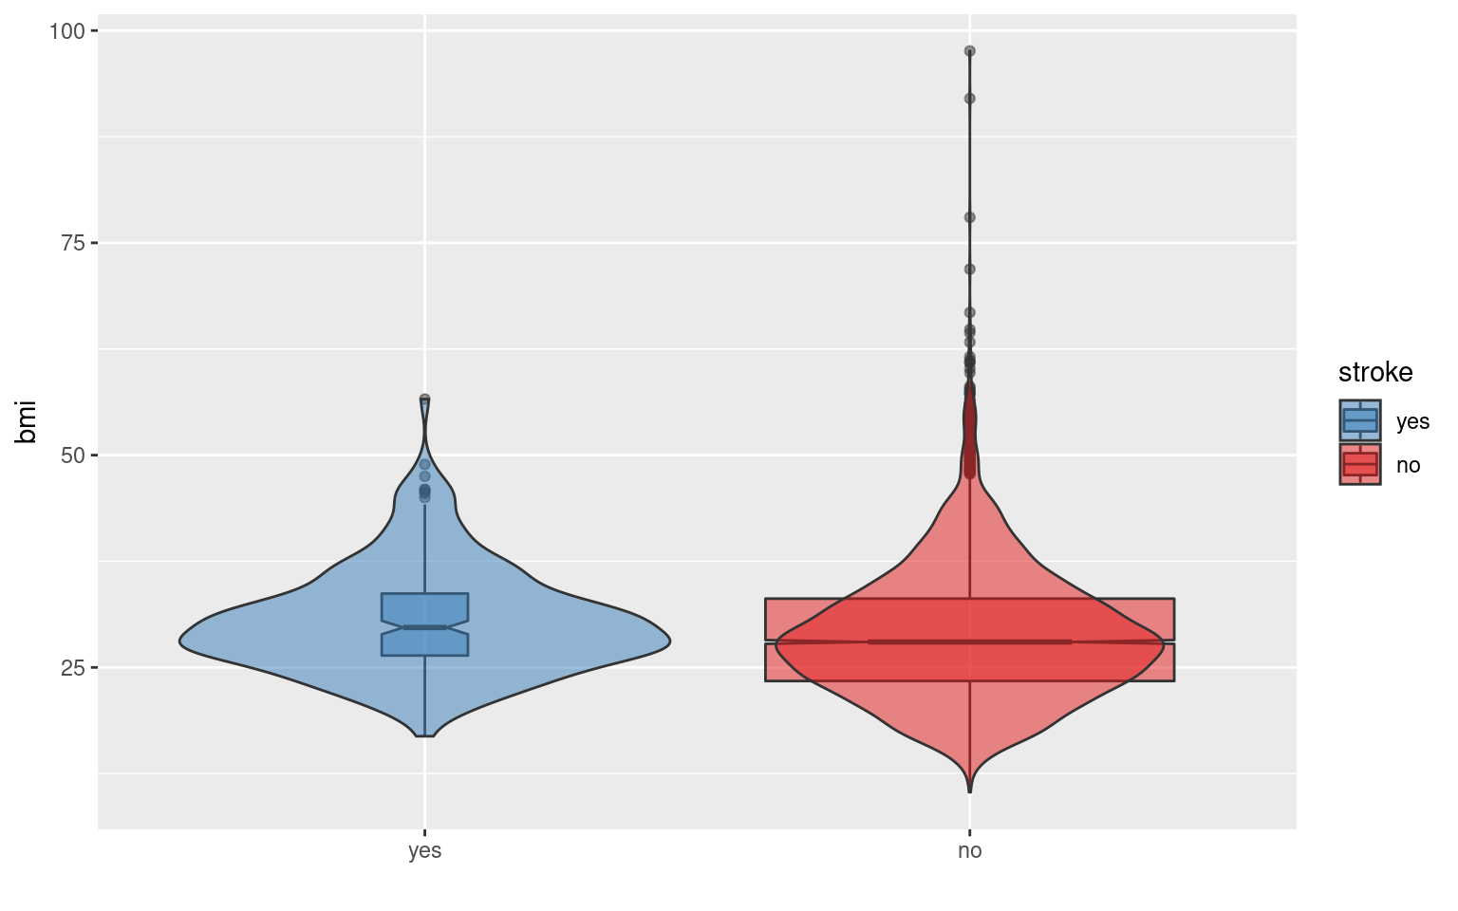
STROKE AND GLUCOSE
High blood glucose levels are usually associated with stroke
STROKE AND BMI
Stroke is seen in people scoring 40 above in BMI

Slide 17
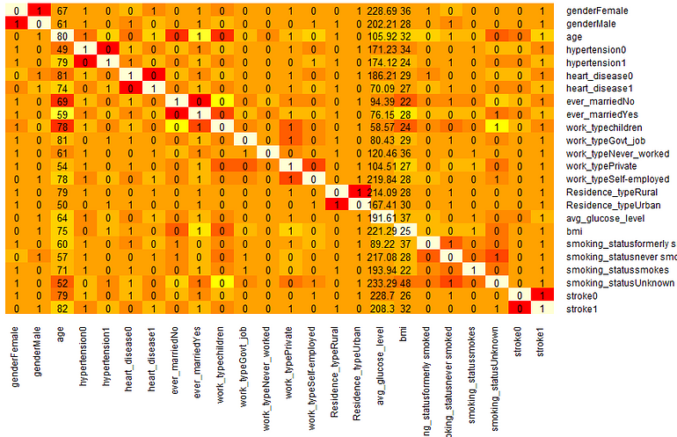
Correlation factor

Slide 18
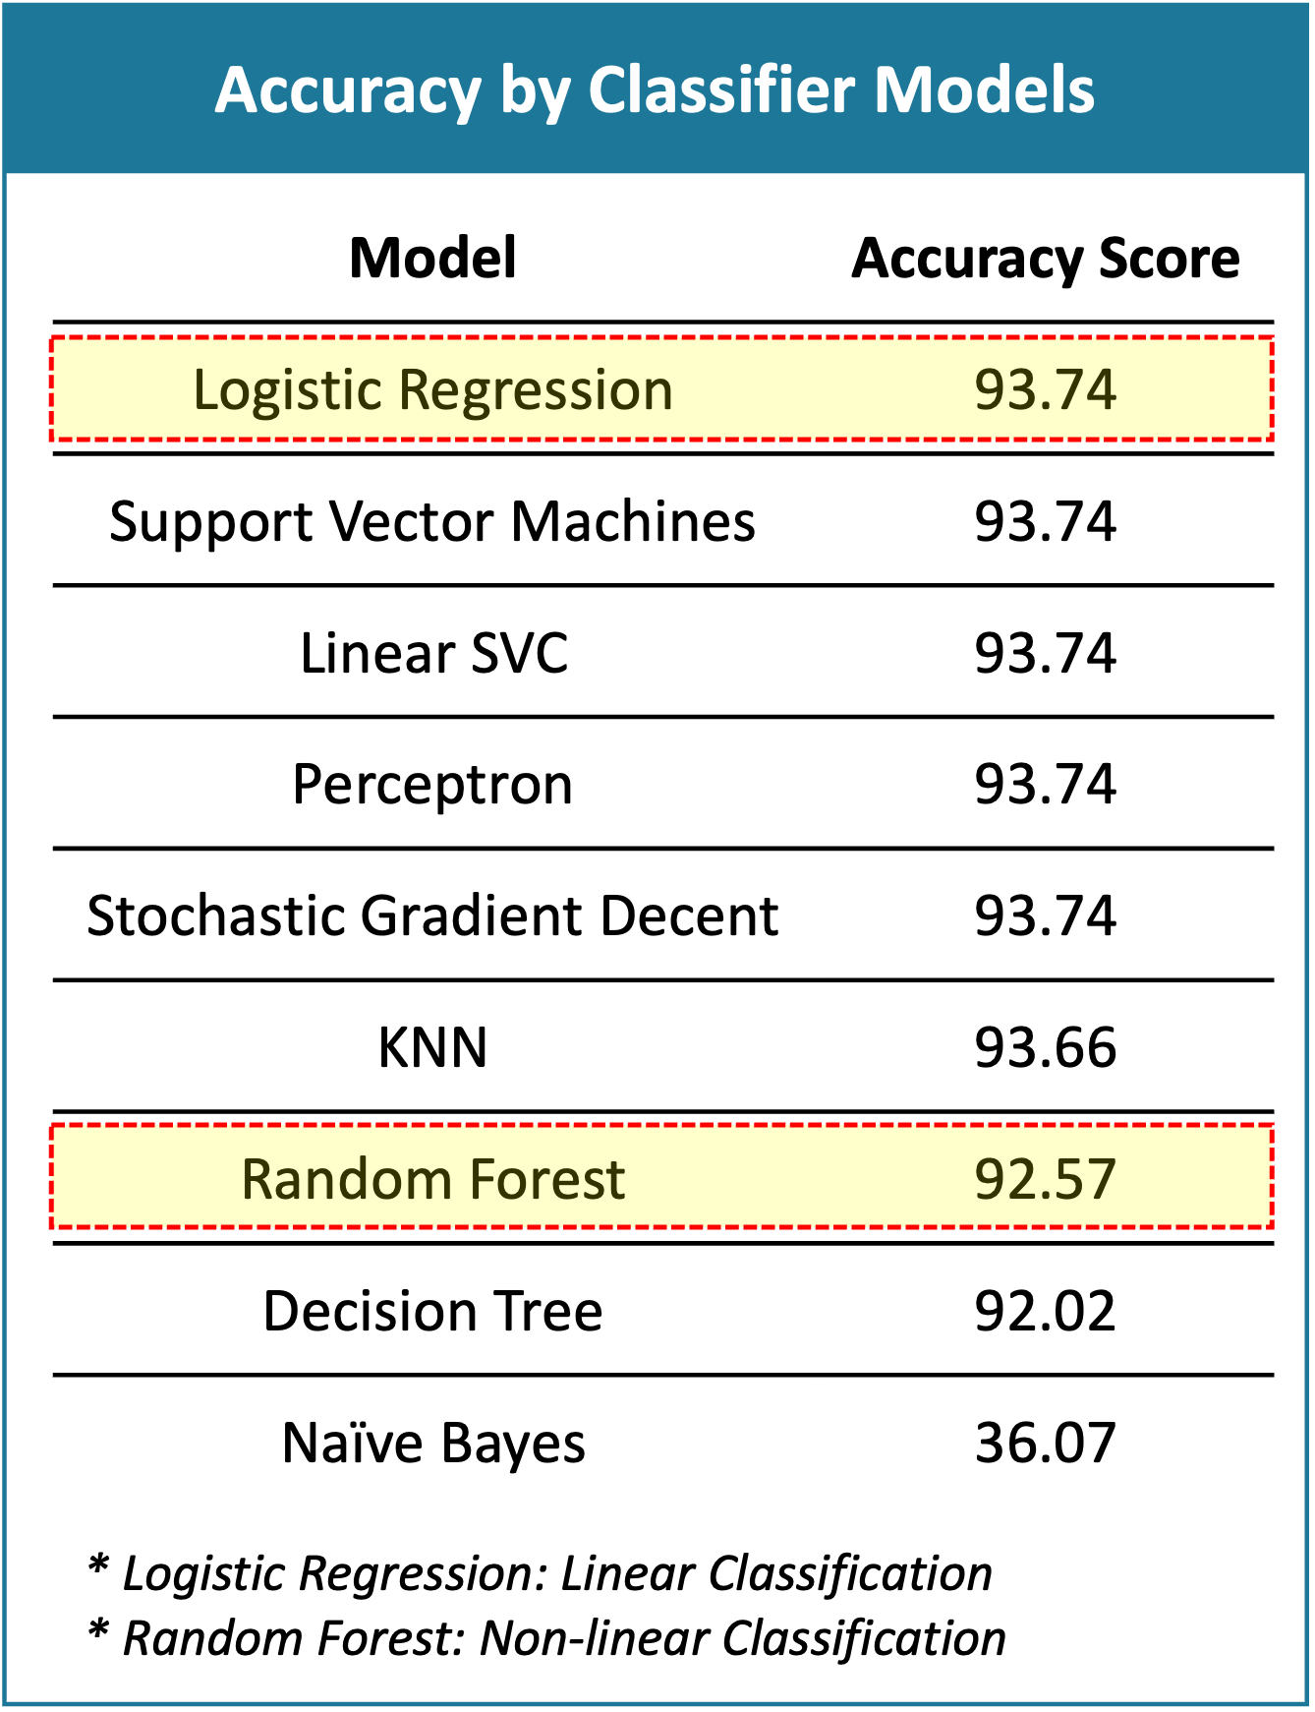
Data Modelling
Converting presented data into models that can be fed with upcoming trial data for predictions
Linear: Logistic regression and confusion matrix, linear svc
Non linear: Support Vector Machine
Ensemble: Random Forest
The factors that influence the choice of model selection are
ROC-AUC Curve which indicates the sensitivity-specificity of the model:
Specificity
Accuracy
J Index

Slide 19
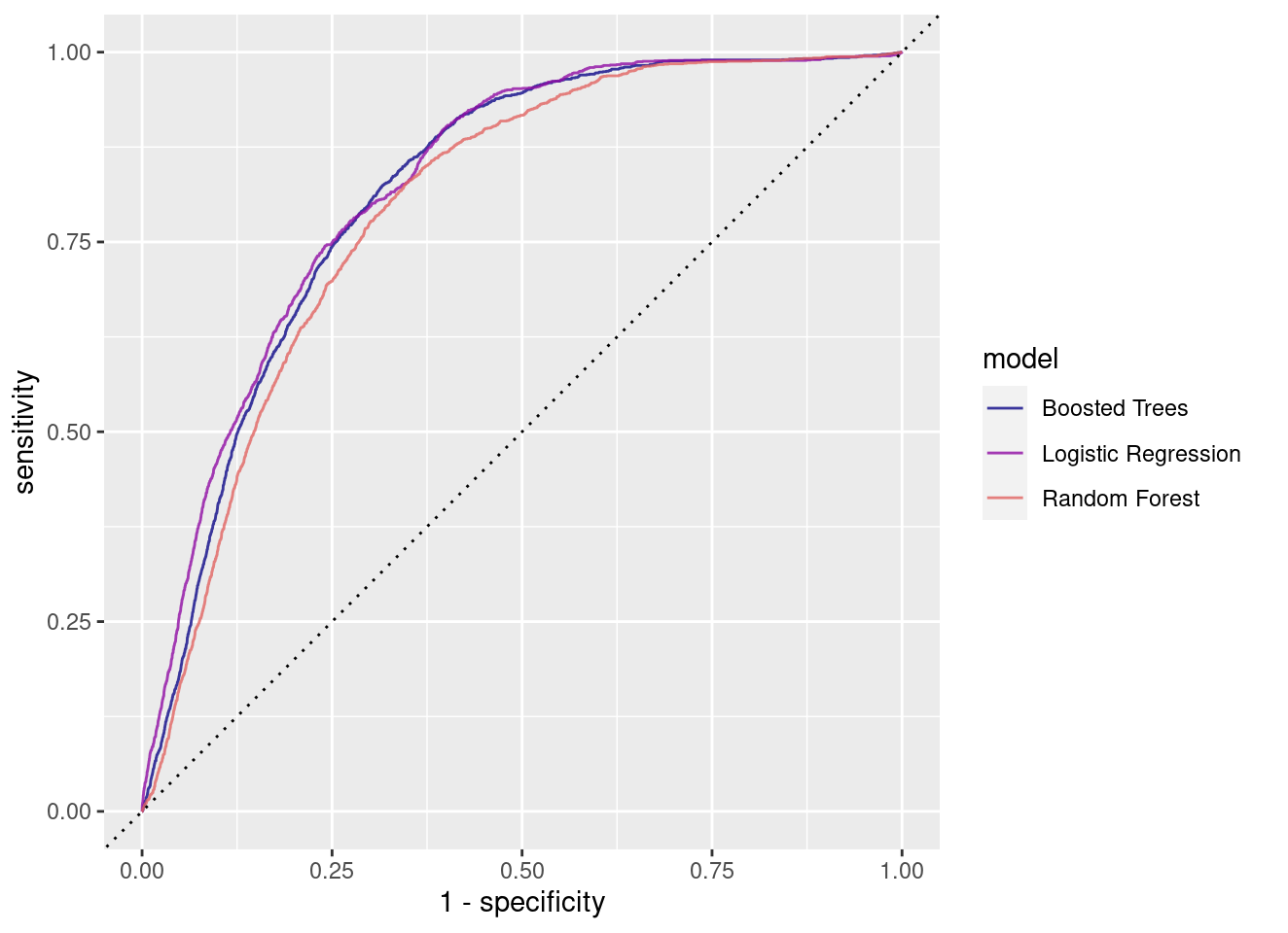
The dataset is split off into training and testing split and metrics library is framed
Each parameter is provided with criteria and is used for prediction
Each model is evaluated by feeding data and its efficiency is measured based on various scales.
Finally, the best fit method is selected to plot the data ie Logistic Regression
Variable importance is calculated to provide exclusion criteria

Slide 20
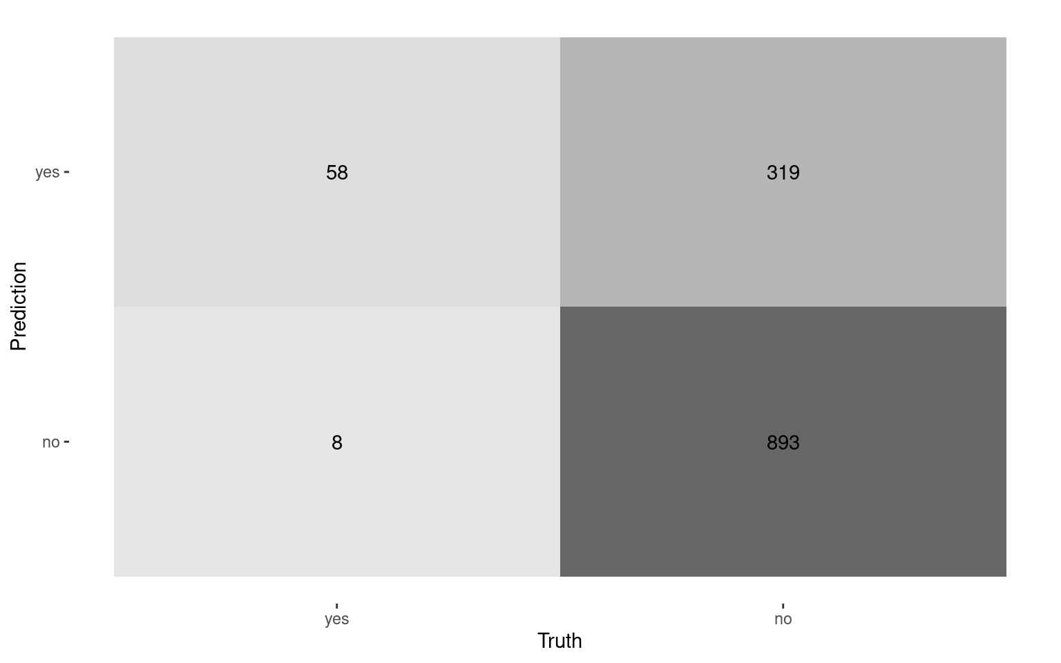
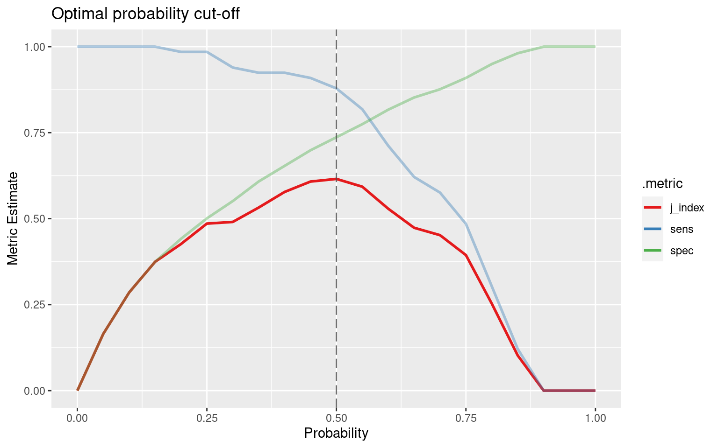
J index and Confusion Matrix
Deals with the 4 parameters- true positives, true negatives, false positives, false negatives.
They indicate the efficiency and accuracy of a formulated model to predict the outcome
J index gives a maximum value of 1 when there are no false positives or false negatives

Slide 21
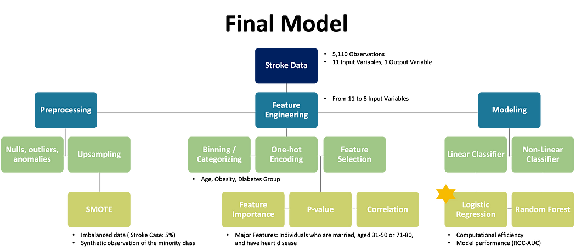

Slide 22
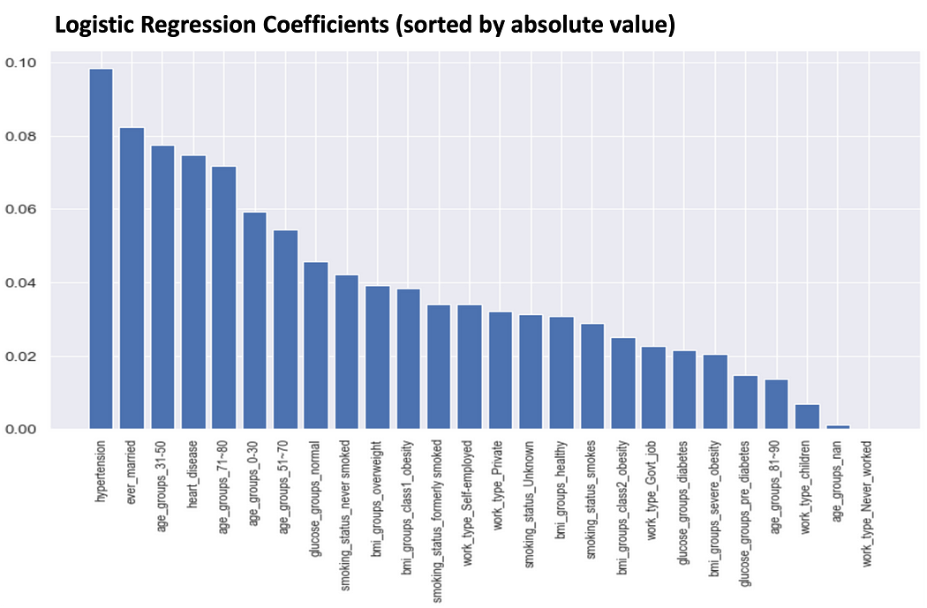
Logistic regression
with the maximum ROC-AUC curve, AUC: Area Under Curve; ROC Curve. ROC stands for Receiver Operating Characteristics-performance measurement for the classification problems at various threshold settings.
It is the best model because of its coefficient analysis and Recall scores.

Slide 23
Scope
The current model takes up to 10 attributes with an accuracy of about 94%
Improvements can be made by integrating with techniques like Hyperparameter tuning, Bayesian optimization, ensembling
Regular monitoring and code reviews should be done to make it adaptive
Apps can be constructed which calculate stroke scores based on input factors. They would guide the individual about daily activities and meals, assist in stressful situations, advise when to consult a doctor, remind medication regimen and most importantly motion and pulse recognition with watches can notify emergency contacts when a person is understroke

Slide 24
Conclusion
we have discussed how to predict strokes based on the healthcare dataset stroke data. We have
demonstrated how to use R code to preprocess the data, perform exploratory data analysis, build a machine
learning model, and evaluate the model’s performance.
The model’s accuracy was evaluated using various metrics such as accuracy, recall, precision, and F1 score.
We also discussed how to improve the model’s performance by adding more relevant features to the dataset, fine-tuning the parameters of the machine learning algorithm, performing feature selection, and using ensemble learning.

Slide 25
THANK YOU

